Slide 1
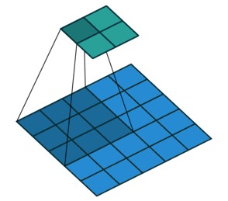
Convolutional Layer

Slide 2
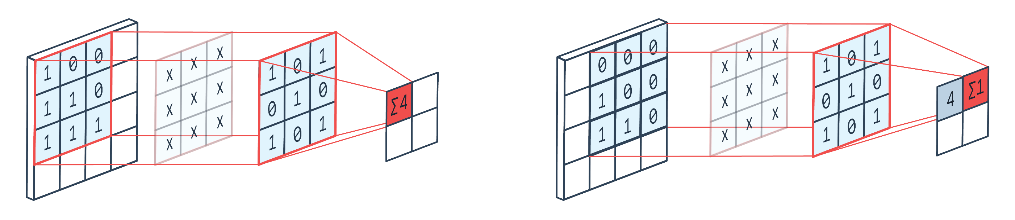
Convolutional Layer
A 2-D convolutional layer applies sliding convolutional filters to the input. The layer convolves the input by moving the filters along the input vertically and horizontally, computing the dot product of the weights and the input, and then adding a bias term.
A filter is a set of kernels (matrices which contain the weights).
A convolution layer is often used in a neural network
\1
\2
Filter
Output
Filter
Output
Input
Input
bias = 0
bias = 0
Notes:
Introduction to a convolutional layer
Math operation in a convolutional layer

Slide 3
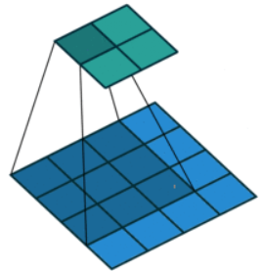
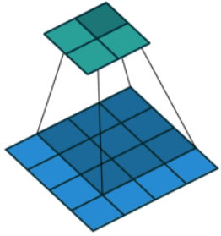
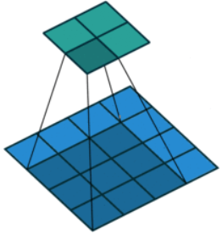
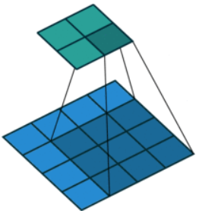
Filter and stride
A set of weights that is applied to a region in the input image is called a filter.
The filter moves along the input image vertically and horizontally, repeating the same computation for each region.
The step size with which the filter moves is called a stride
The number of weights in a filter is h * w * c, where:
h is the height, and w is the width of the filter
c is the number of channels in the input.
The number of filters determines the number of channels in the output of a convolutional layer
This image shows a 2-by-2 filter scanning through the input with a stride of 1
Notes:
Filter: a set of weights that is applied to a region in the input image
Stride: the step size with which the filter moves
Link to animation: https://it.mathworks.com/help/deeplearning/ref/nnet.cnn.layer.convolution2dlayer.html#mw_a67e7d3e-297d-472f-8e47-5727a7c2f371

Slide 4
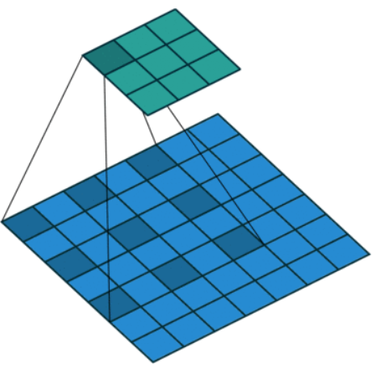
Dilated Convolutions
A dilated convolution is a convolution in which the filters are expanded by spaces inserted between the elements of the filter.
The dilated convolutions is used to increase the receptive field (the area of the input which the layer can see) of the layer without increasing the number of parameters or computation.
The layer expands the filters by inserting zeros between each filter element.
Each filter corresponds to an effective filter size of (Filter Size – 1) * Dilation Factor + 1.
For example, a 3-by-3 filter with the dilation factor [2 2] is equivalent to a 5-by-5 filter with zeros between the elements.
This image shows a 3-by-3 filter dilated by a factor of two scanning through the input. The lower map represents the input and the upper map represents the output
Notes:
The dilated convolution is used to increase the receptive field (the area of the input which the layer can see) of the layer without increasing the number of parameters or computation.

Slide 5
Feature map
Input
As a filter moves along the input, it uses the same set of weights and the same bias for the convolution, forming a feature map.
Each feature map is the result of a convolution using a different set of weights and a different bias.
Hence, the number of feature maps is equal to the number of filters. The total number of parameters in a convolutional layer is ((h*w*c + 1)*Number of Filters), where 1 is the bias.
Filter 1
Filter 2
Convolution
Feature Map 1
Feature Map 2
Output
Notes:
The feature map is the result of a convolution with a filter

Slide 6
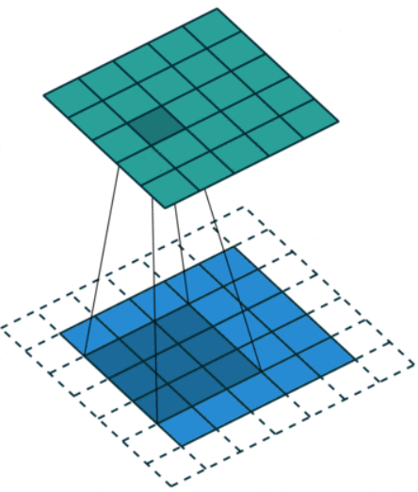
Padding
Padding is rows or columns of element added to the borders of an image input.
By adjusting the padding, it is possible to control the output size of the layer.
Zero padding consists in adding rows or columns of zeros to the borders of the image.
This image shows a 3-by-3 filter scanning through the input with padding of size 1. The lower map represents the input and the upper map represents the output.
Notes:
Padding is used to control the output of a convolutional layer

Slide 7
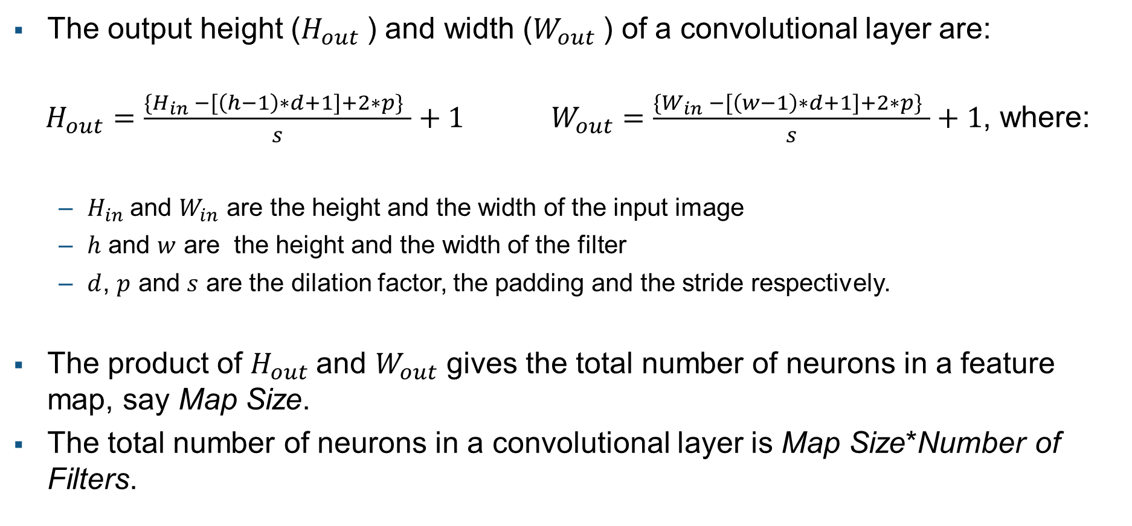
Output size
The output height ($H_{out}$) and width ($W_{out}$) of a convolutional layer are:
$H_{out}=\frac{\{H_{in} −[\left(h−1\right)∗d+1]+2∗p\} }{s}+1 W_{out}=\frac{\{W_{in} −[\left(w−1\right)∗d+1]+2∗p\} }{s}+1$, where:
$H_{in}$ and $W_{in}$ are the height and the width of the input image
$h$ and $w$ are the height and the width of the filter
$d$, $p$ and $s$ are the dilation factor, the padding and the stride respectively.
The product of $H_{out}$and $W_{out}$ gives the total number of neurons in a feature map, say Map Size.
The total number of neurons in a convolutional layer is Map Size*Number of Filters.
Notes:
For example, suppose that the input image is a 32-by-32-by-3 color image. For a convolutional layer with eight filters and a filter size of 5-by-5, the number of weights per filter is 5 * 5 * 3 = 75, and the total number of parameters in the layer is (75 + 1) * 8 = 608. If the stride is 2 in each direction and padding of size 2 is specified, then each feature map is 16-by-16. This is because (32 – 5 + 2 * 2)/2 + 1 = 16.5, and some of the outermost zero padding to the right and bottom of the image is discarded. Finally, the total number of neurons in the layer is 16 * 16 * 8 = 2048.

